Slide 1
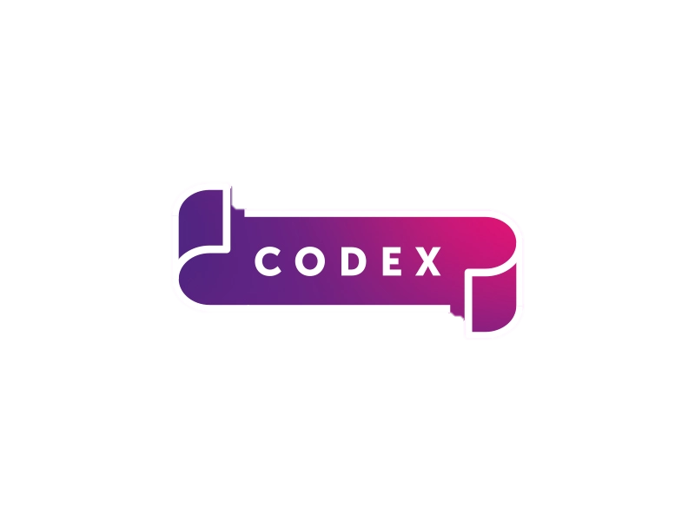
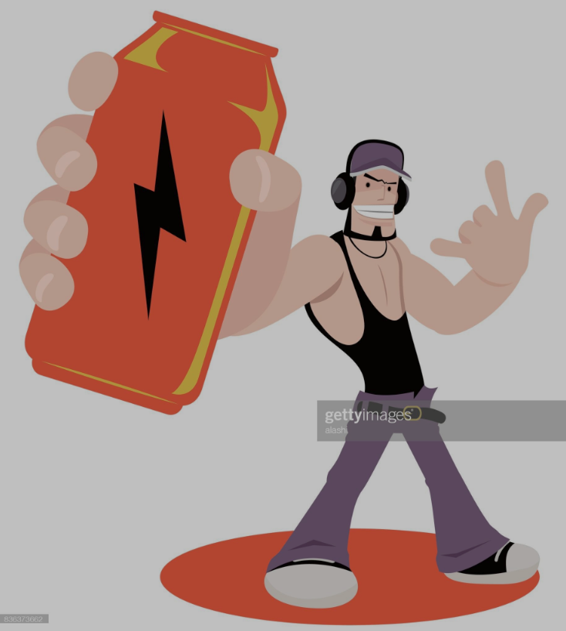


Provide Insights to the Marketing Team in Food & Beverage Industry
Codex
Resume Project challenge no. 6
Submitted by Sudipta

Slide 2

About The Company
Code X is a German beverage company that is aiming to make its mark in the
Indian market.
They launched their energy drink in 10 cities of India . After 6 months they conducted a
survey in those 10 cities and received results from 10k respondents.
Peter Pandey, a marketing data analyst is tasked to convert these survey results to
Meaningful insights which the team can use to drive actions.

Slide 3
Objective
Primary Insights
Secondary Insights
(Recommendations)

Slide 4

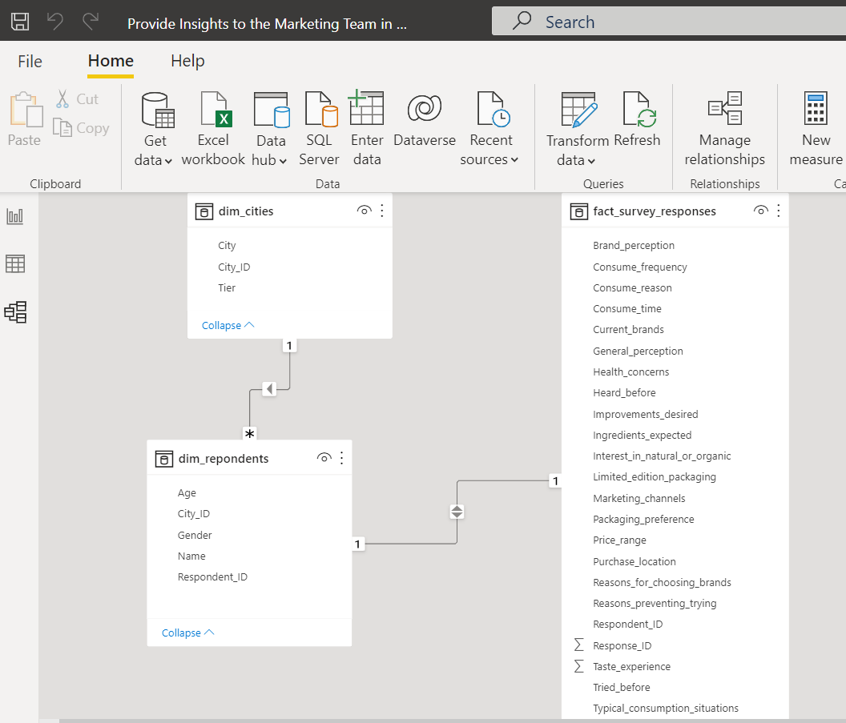
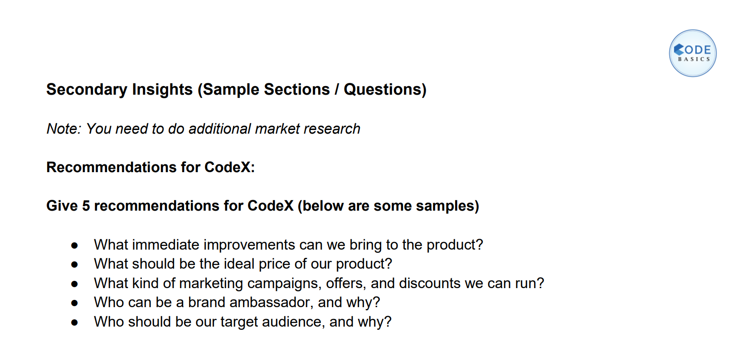
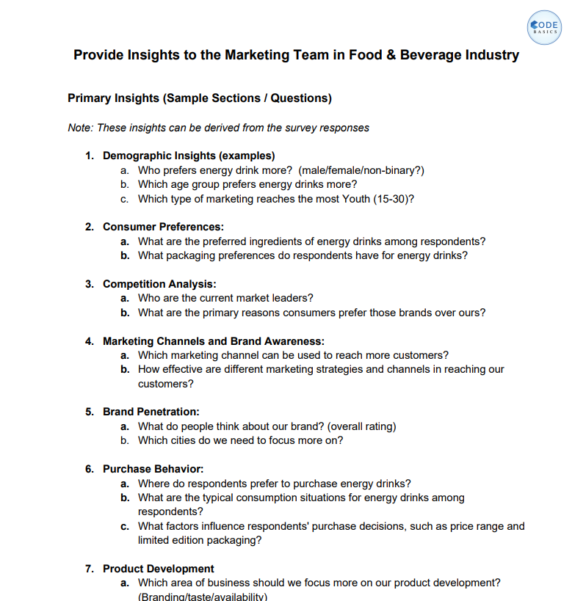
Task
&
Data Set

Slide 5
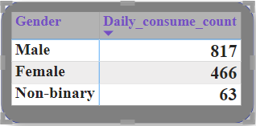
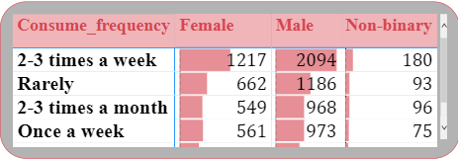
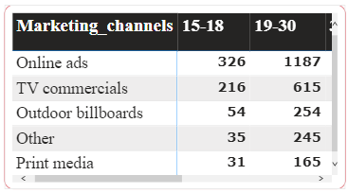
Demographic Insights
Who prefers energy drink more (male/female/non-binary?)
Key Insights
Male prefers energy drink more because the Consume frequency of male is
about 61% whereas consume frequency of female is about 35% and for non
binary is 4% on daily basis.
Monthly , weekly consume frequency of male is higher compare to that of
female and non-binary.
Which type of marketing reaches the most Youth (15-30)?
Key Insights
Online Ads marketing channels reaches
the most youth from the age between
(15-30) followed by TV Channels.

Slide 6
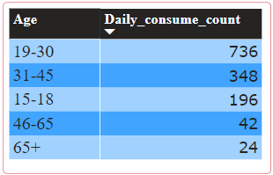
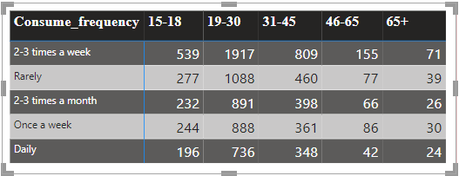
Which age group prefers energy drinks more?
Key Insights
The percentage of individuals between the ages of (19 -30) is
approximately 54% and for the age
between (31-45) is 25% on daily basis.
Among 10k respondents, approximately 13% of individuals across
all age groups are consuming energy drinks on a daily basis.

Slide 7
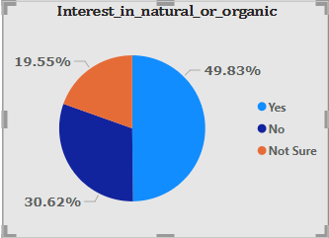
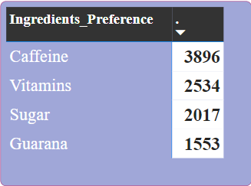
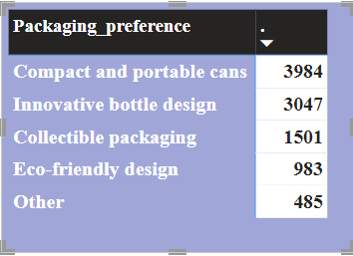
Consumer Preferences
What are the preferred ingredients of energy drinks among respondents?
Key Insights
39% of the respondents preferred caffeine and
approximately 25% of respondents preferred vitamins.
The least preferred ingredients are sugar & Guarana with
20% & 16%.
Note : Research has found several potential health benefits to consuming
caffeine. It improves mood, help brain work better and improve
performance during exercise.
What packaging preferences do respondents have for energy drinks?
Key Insights
40% of Respondents prefer compact and portable cans as the preferred type of packaging whereas 30% of the respondents favored innovative bottle designs.

Slide 8
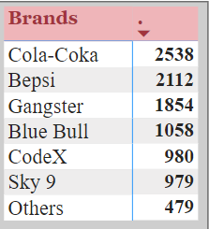
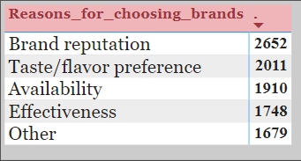
Competition Analysis
Who are the current market leaders?
Key Insights
Cola-coka is currently the market leader, holding a market share of 25%. It is followed by Pepsi with 21% market share, Gangster with 18%, and Blue Bull with 11%.
Codex holds 10% of the market share .
What are the primary reasons consumers prefer those brands over ours?
Key Insights
26% of the respondents prefer the brand reputation as the primary reason
Approximately 20% of the respondents cited taste/flavor
Whereas 19% of the respondents mentioned availability.

Slide 9
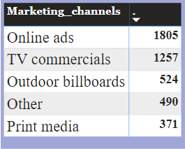
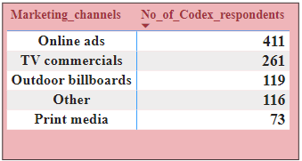
Marketing Channels and Brand Awareness
Which marketing channel can be used to reach more customers?
Key Insights
Both online ads and TV commercials can be effective as they are contributing approximately 40% and 28% respectively in reaching customers.
How effective are different marketing strategies and channels in reaching our customers?
Key Insights
Approximately 41% of customers got to know through online ads, while 26% of customers through TV commercials.
About 12% of the customers from Outdoor Billboards & 11% of the customers from Other.

Slide 10
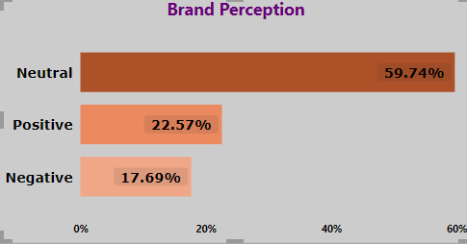
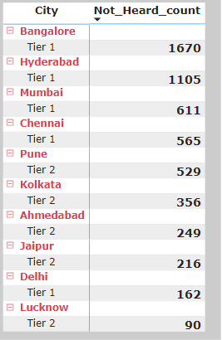
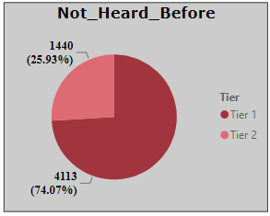
Brand Penetration
What do people think about our brand? (overall rating)
Key Insights
About 61% of the respondents have a neutral opinion and 22% of the people have a positive perception whereas 17% of the people have a negative perception about the brand.
Which cities do we need to focus more on?
Key Insights
Out of the 10k respondents, approximately 5.5k (55%) of them are not aware of Codex energy drink..
Out of the 5.5k respondents who are not aware of Codex energy drink, 74% respondents are from TIER 1 cities and rest 26% are from TIER 2 cities.
We should focus on cities like Bangalore, Hyderabad, Mumbai, Chennai, Pune.

Slide 11
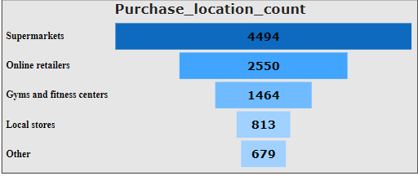
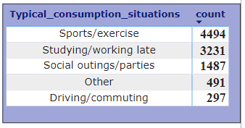
Purchase Behaviour
Where do respondents prefer to purchase energy drinks?
Key Insights
45% of customers prefer to purchase energy drink from Super markets, 25% of customers prefer to buy from online retailors and 14% of the customers prefer to buy from gym & fitness centres.
What are the typical consumption situations for energy drinks among respondents?
Key Insights
During sports/exercise 45% of customers consume energy drink.
32% of customers consuming energy drink While Studying or working late .
During Social outings/parties 15% of customers consume energy drink also 3% are consuming while driving/commuting.

Slide 12
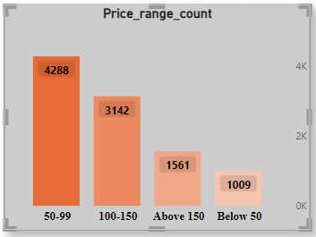
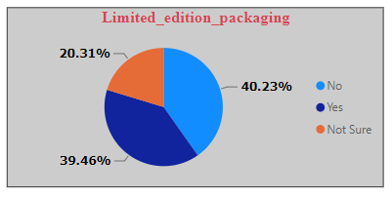
What factors influence respondents' purchase decisions, such as price range and limited edition packaging?
Key Insights
42% of people expressed their preference for purchasing the energy drink within the price range of Rs50-99.
Based on the data, it indicates that approximately 40% of people showed interest in limited edition packaging for the energy drink, while the remaining 40% did not express much interest in it..

Slide 13
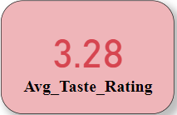
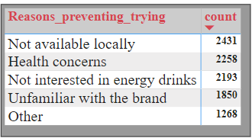
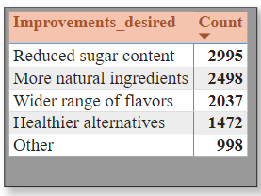
Product Development
Which area of business should we focus more on our product development? (Branding/taste/availability)
Key Insights
Based on an average taste rating of 3.28, it suggest that there is room for improvement in the taste of energy drink.
Availability of the product is another crucial aspect of the business. 24% of customers face difficulties in finding the product at local stores,
while 18% of customers are still unfamiliar with the brand.
25% of people are health-conscious, so it is important to make the energy drink with reduced or minimal sugar content. Additionally, we should incorporate more natural ingredients.
It would be beneficial to expand the range of flavors offered while ensuring that these flavors include healthier alternatives.

Slide 14

What immediate improvements can we bring to the product?
Approximately 55%, of the people are still unaware of the energy drink. To address this issue, it is recommended to make immediate changes to the marketing strategy.
We can Increase brand awareness campaigns, Engage with influencers, we can go for online marketing optimization in cities like Bangalore, Hyderabad, Mumbai, Chennai Pune & Kolkata.
We should add more flavors that include healthier alternatives.
We have to make plans to improve the local availability of the product by collaborating with different distribution channels to expand the business because the availability of the product is crucial.

Slide 15
What should be the ideal price of our product?
Based on the insights generated, approximately 42% of them prefer the price range between $50-99.
Therefore, it is recommended to set the ideal price within this range as it aligns with the affordability of the target age group (19-30) on a daily basis. Once a substantial customer base is acquired, there can be further consideration for reworking the pricing strategy.
What kind of marketing campaigns, offers, and discounts we can run?
Marketing Campaigns:
Digital marketing and influencer marketing campaigns.
Organize sampling initiatives at events, gyms, health clubs, and supermarkets.
Collaborations with sports organizers, the tour & travel industries.
Offers & Discount:
special introductory discount for new customers.
Introduce a subscription-based model.
Encourage customers to refer their friends and family by offering incentives.
At shops & Supermarkets we can make offers like “Buy 5 get 2 free”
recharge coupons, free energy bar chocolate etc.
.

Slide 16
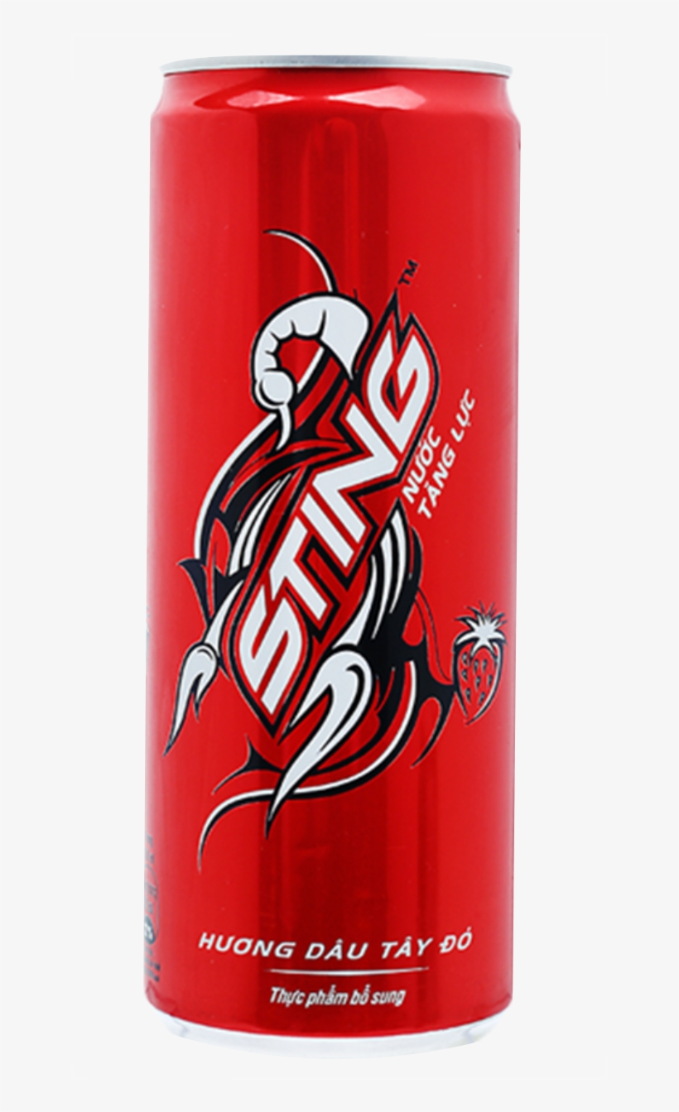
Case Study: STING Energy Drink
As we all know about the sting energy drink and it is making waves in the Indian market
from the past few years.
Sting did wonders in marketing their product Sting did the creative marketing .
They implemented some amazing concepts in their advertisements,
such as “get yourself a drink and you are energized enough to charge a car”.
This resonated with their target audience and led to a significant increase in sales.
STING hit a marketing masterstroke with an ad where a male protagonist, after drinking STING,
lifts a female to the tenth floor, and at the end, she leaves a number for him.
Then, STING played their masterstroke by setting a pre-recorded message that talked
about saving energy and reminded the caller to have a drink to kickstart their routine.
The brand received over 40,000 calls on the same number in just 48 hours.
This was an excellent example of how the best marketing doesn’t look like marketing.

Slide 17
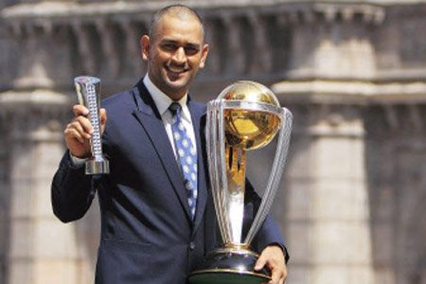
Who can be a brand ambassador, and why?
In my Opinion MS Dhoni can be a brand ambassador.
MS Dhoni is a widely recognized and highly respected cricketer, both in India and internationally.
His fans include not only the youth but also kids and senior citizen. It will truly help to approach and convince people of all ages to give it a try at least once.
Dhoni is known for his exceptional fitness and endurance. This resonates with the brand's positioning and can inspire consumers to believe that the energy drink can enhance their own performance and stamina.
Dhoni's involvement as a brand ambassador can open up various marketing opportunities. This may include promotional campaigns, advertisements, social media collaborations, and public appearances.

Slide 18
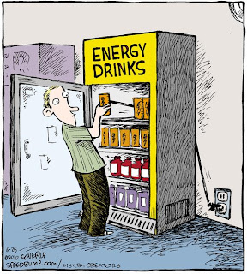
Who should be our target audience, and why
Energy drinks tend to be popular among young & adults, typically between then ages of
15 and 35. This age group is often seeking a boost of energy to support their active and busy lifestyles, including work, studies, and social activities.
The target audience, ranging from ages 15 to 35, includes students, adults, professionals, athletes, and fitness enthusiasts.
Students-
College and university students often consume energy drinks to stay awake and
focused during long study sessions
Professionals:
Individuals with demanding jobs, such as professionals working long hours,
night shifts, or in physically demanding roles, may rely on energy drinks to
help them stay energized and maintain productivity.
Athletes, and fitness enthusiasts:
Energy drinks are also popular among athletes and fitness enthusiasts
who are looking for an energy boost before or during workouts.

Slide 19

Mr. Dhaval Patel sir & Hemanand Vadivel sir for the amazing support

